Slide 1


By BrainStew Studios

Slide 2
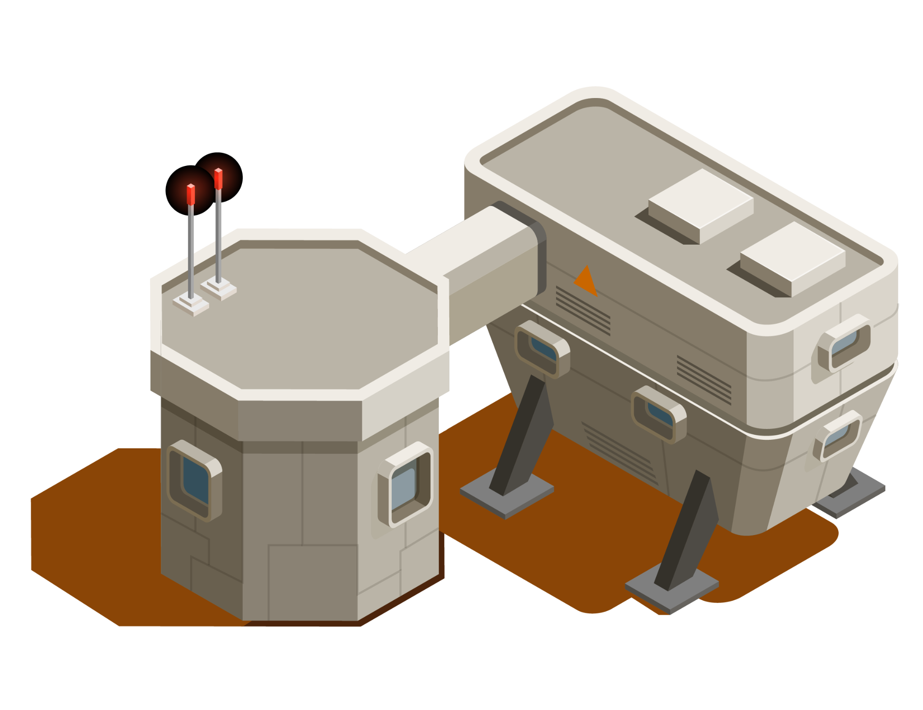

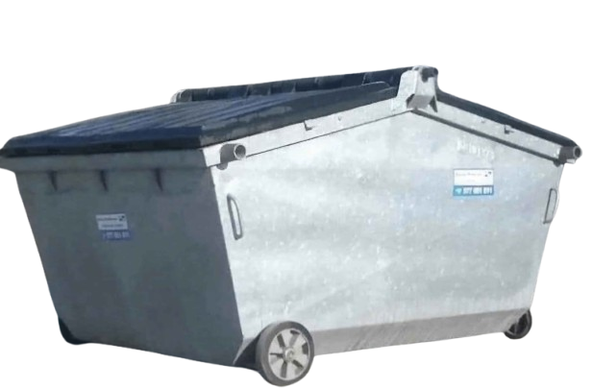
Game Description
You are an AmazÖn warehouse employee in the year 3000, on the newly colonized planet, MARS. After working minimum wage for many martian years, you've decided to overthrow the evil capitalist overlords, Jimmy Beez, Marz Suckabörg, and Enron Milk.
Battle different types of enemies like warehouse bots, drones, underground reptiles, and murderous trucks in your quest to stop the ruling class!
GOALS:
The goal of our game is a hype fast-paced 2D run-and-gun platformer with some bullet-hell chaos facing enemy-filled levels inspired by dystopian factories, data farms, and dark colonies.
We hope to have immersive world-building with dark humor and satire along with solid player mechanics.

Slide 3

Meet the Team!
CORY CLAIRMONT
JILLIAN JABBES
ANDREW SORENSEN
TL1
TL2
TL2+
BIDHI PAUDEL
NIHAT POLAT
ANEESHA SHRESTHA
CHENNY AMADIKE
TL3
TL4
TL5
TL6

Slide 4
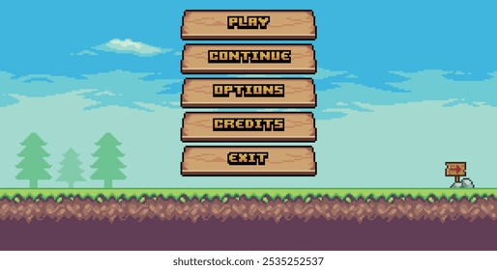
Scene 1: Main Menu
Chenny
Action:
Player launches game first into menu. It has different action buttons to select
Player can press (Play, Options, Quit)
Dialogue:
None
Notes:
Background menu music playing

Slide 5
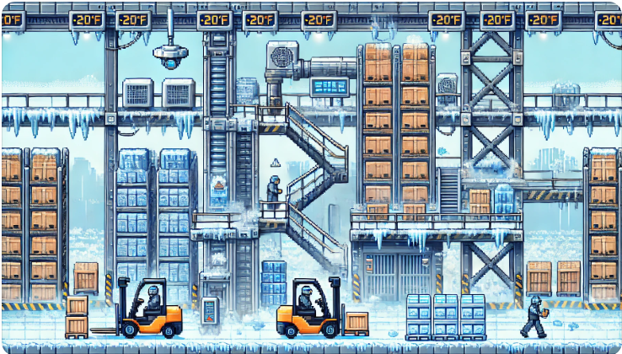
Scene 2: Tutorial
Jillian
Action:
You awaken feeling terribly cold and tired…you spawn in the warehouse freezer. You need to get out
Introduce player to movement controls
Attack basic enemies to learn combat mechanics
Dialogue:
Tutorial Instructions
An old bot’s wise words
Notes:
Easy difficulty

Slide 6




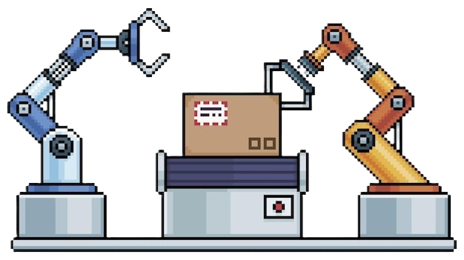



Level 1: Amazöön
Kayra
Action:
Move through warehouse platforming section
Attack enemy swarms
Camera follows MC, horizontal motion
Collect worker notes to locate + get in boss room
Dialogue:
None
Notes:
Easy Level
Ends with Boss Battle Jimmy Beez

Slide 7






Level 2: Circuit Caves
Aneesha
Action:
Move through circuit cave sections
Attack/dodge enemies
Camera follows MC, vertical motion
Dialogue:
None
Notes:
Medium Level
Ends with Marz Suckabörg Boss Battle

Slide 8
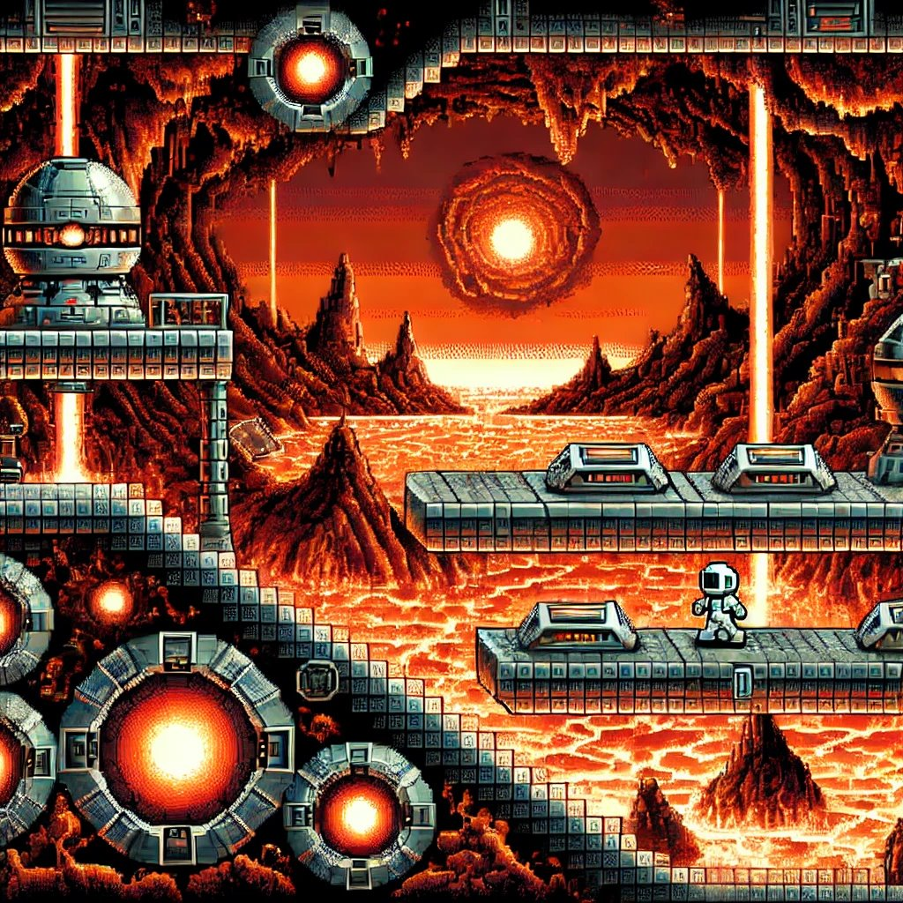
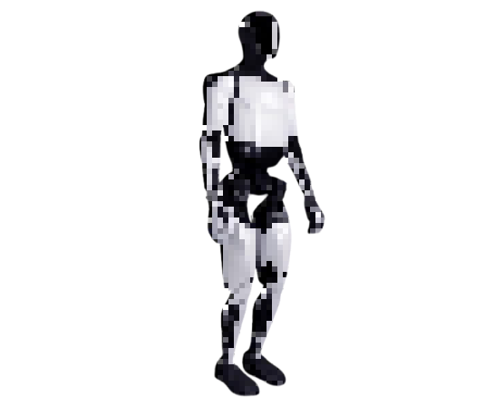
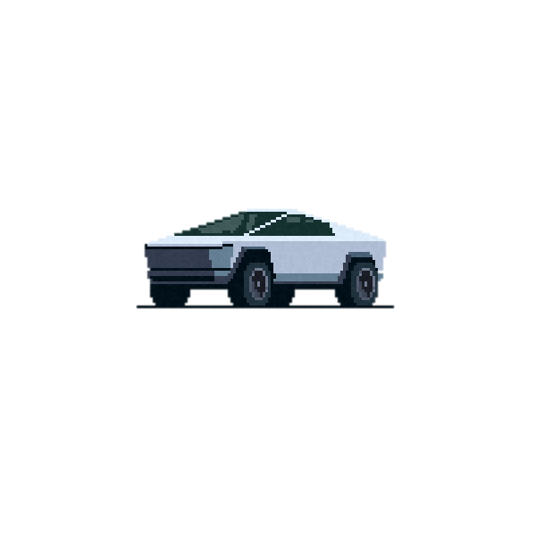



Level 3: The Core of Mars
Cory
Action:
You move through platforms and jump lava
Attack/dodge enemies
Camera follows MC, horizontal motion
Dialogue:
None
Notes:
Hard Level
Ends with Enron Milk Boss Battle

Slide 9
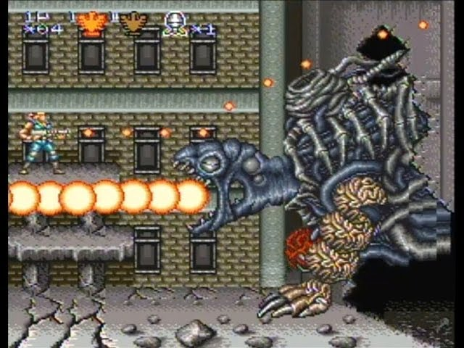
Boss Battle
Andrew
Action:
Boss theme music
Camera changes from moving to fixed
Fights boss until heath depletes
Dialogue:
Boss quotes
Notes:
Involves a set arena

Slide 10
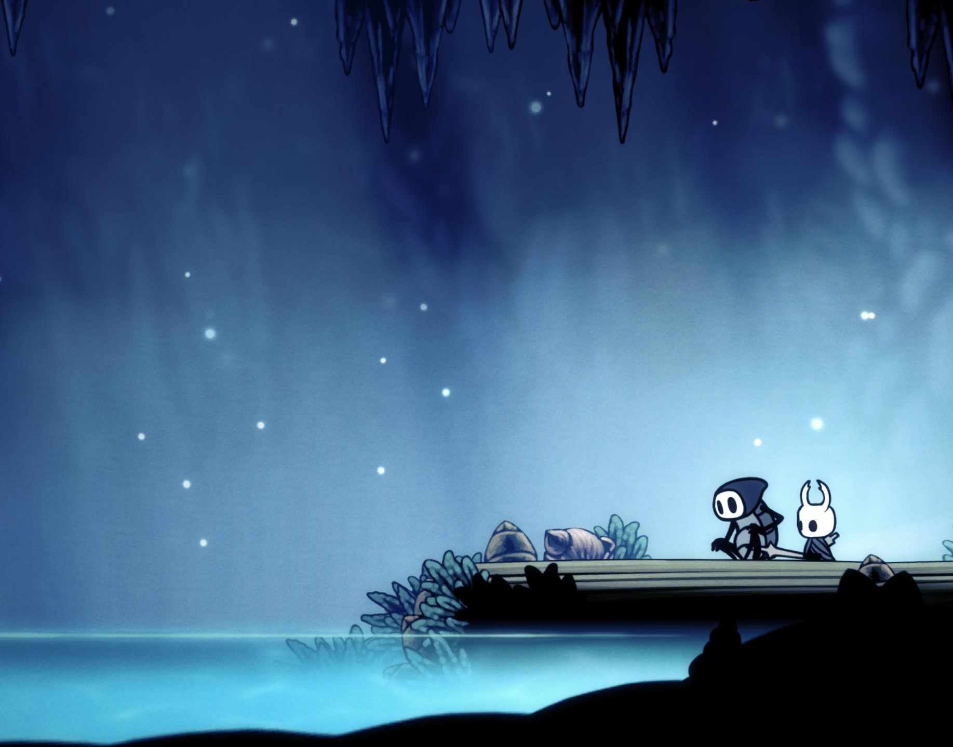
Victory Screen
Bidhi
Action:
Music theme changes
Camera changes from moving to fixed
Dialogue:
Credits roll
Notes:
Involves 1 or 2 atmospheric scene

Slide 11
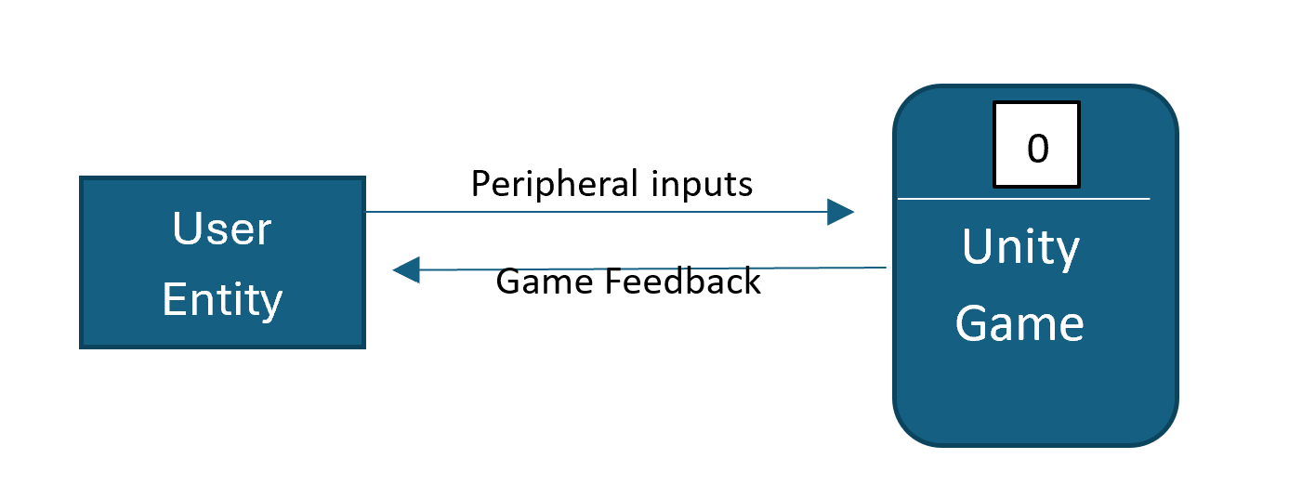
Cory​
Data Flow Diagram: Context

Slide 12
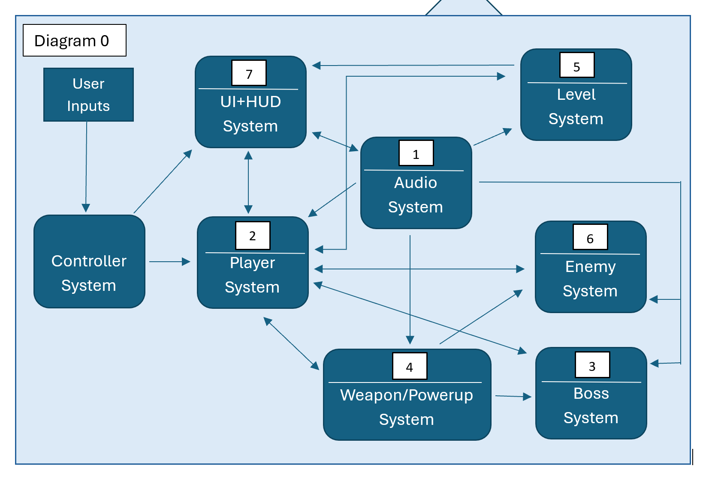
Data Flow Diagram: Level 0
Cory​
Entity: User Subsystems: 1 - Cory 2 - Jillian 3 - Andrew 4 - Bidhi 5 - Kayra 6 - Aneesha 7 - Chenny

Slide 13
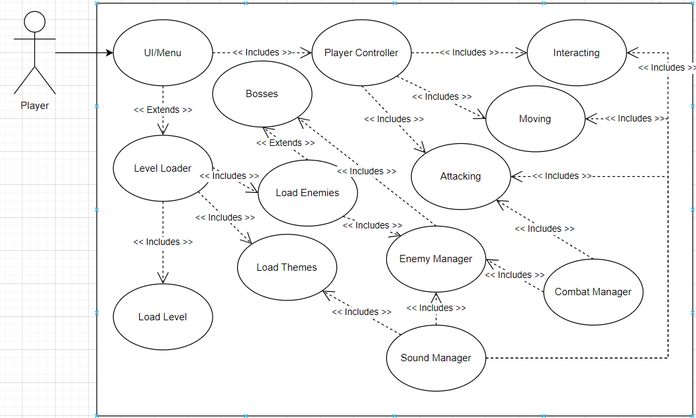
Global Use Case

Slide 14
Game Features
Subsystem Breakdown

Slide 15

Cory Clairmont – Subsystem 1
Audio Management
Sound Effects
Background Music
Menu Music
Boss Themes
Priority: 3
Complexity: 6/10

Slide 16
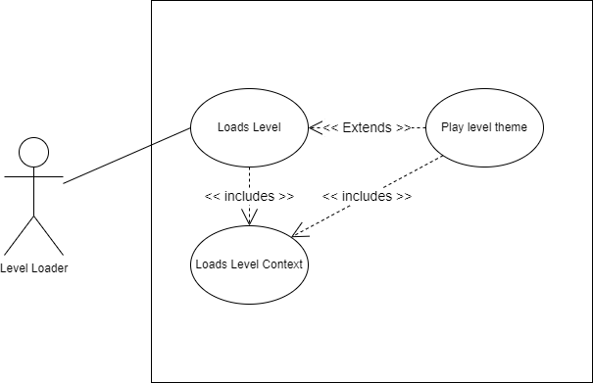
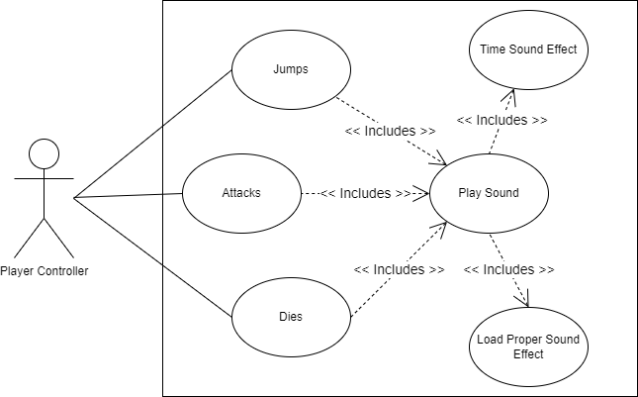
Use Case Diagram - TL1

Slide 17
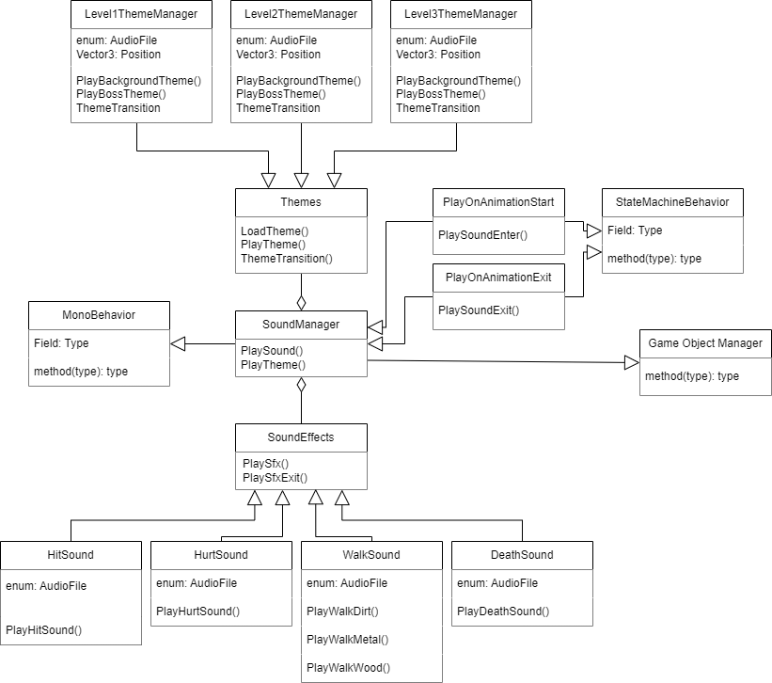
Class Diagram – TL1

Slide 18
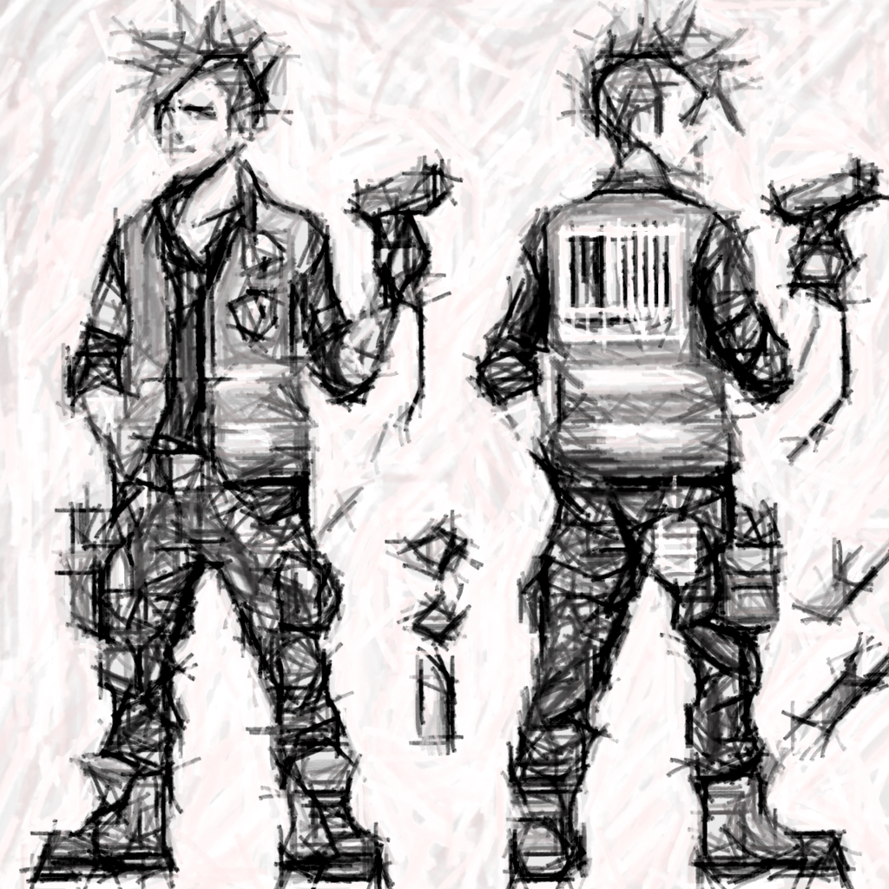
Jillian – Subsystem 2 Player Character
Priority: 1 (Critical)
Complexity: 7/10
Player Movement: User moves the character to navigate 2D levels
Basic Movement
User Input mapped to those movement actions
Physics/Collision
Player Combat: Engage with hostile enemies
Player stats
Inventory -> to hold weapon & powerups
Hitbox
Attack -> Call weapon if weapon + powerup buff if powerup
Taking damage
Player Sprite Animation: Character brought to life
State machine -> Manage different states & trigger correct animations
Sprite sheet -> Visual representations for different states
Animation calls

Slide 19
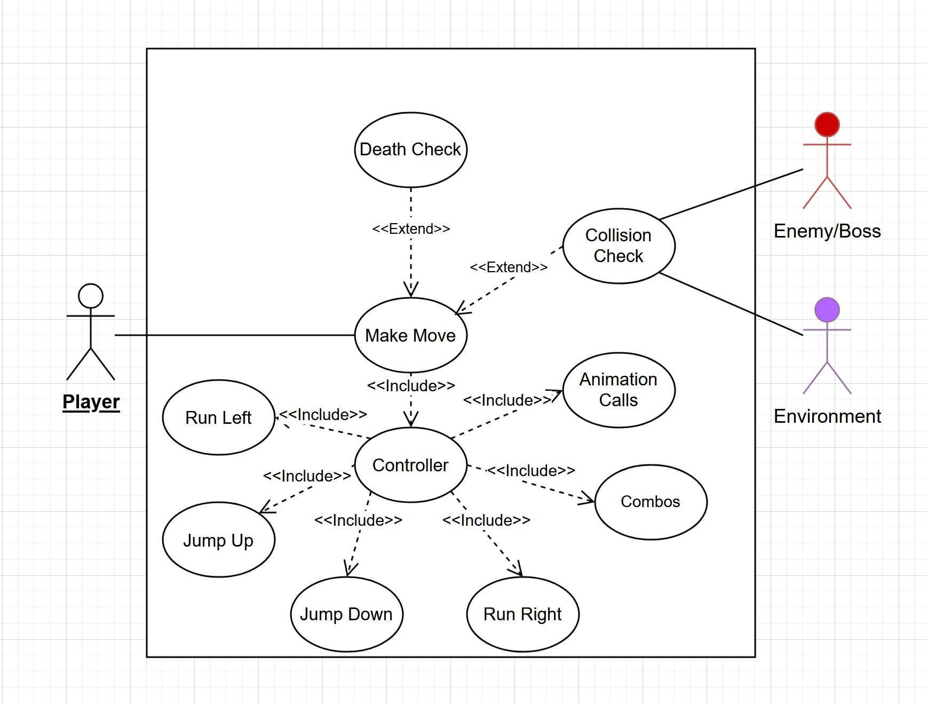
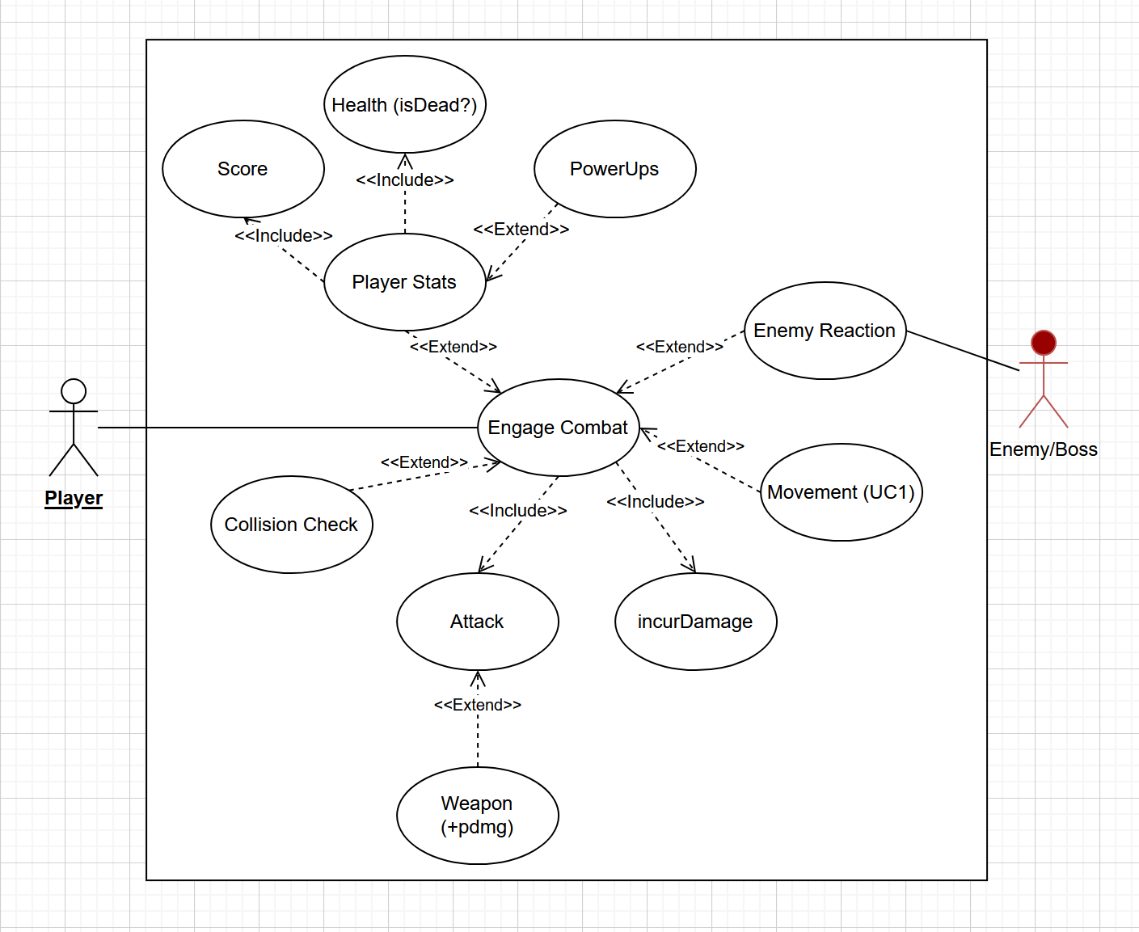
Jillian – Use Case Diagram

Slide 20
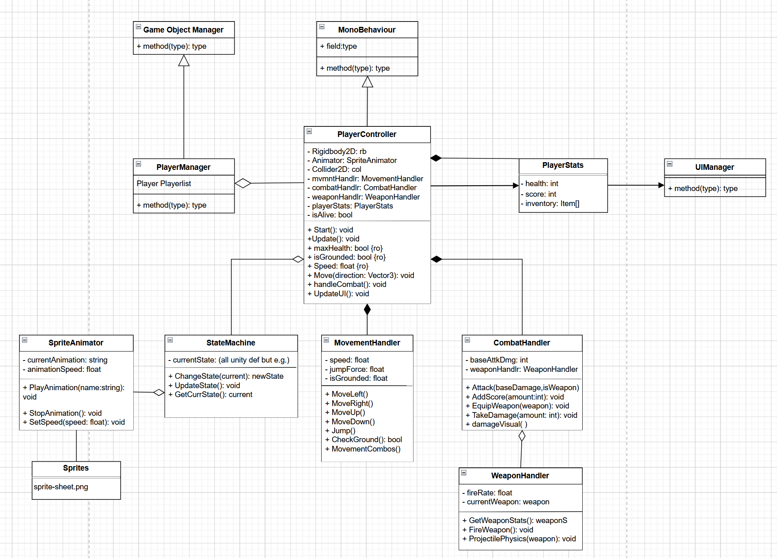
Jillian – Class Diagram

Slide 21
Andrew S – Subsystem 3 Bosses
Bosses
Boss Object
Movement (Semi-Randomized)
Ranged Attacks and Melee/Contact Damage
Each boss type has their own on-theme attack
Boss Phases
Next Phase is Initiated -> health threshold
Change Movement
Change Attack
Priority: 1
Bosses are a core part of the gameplay and story
Complexity: 8/10
Making movement and dynamic phases for all bosses is time consuming

Slide 22

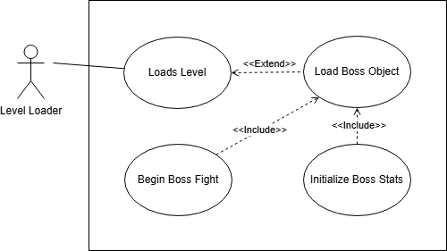
Andrew – Use Case Diagram

Slide 23
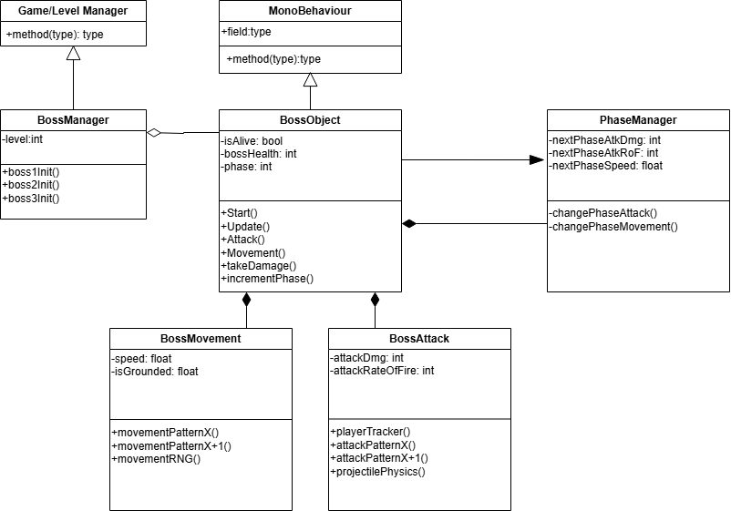
Andrew – Class Diagram

Slide 24
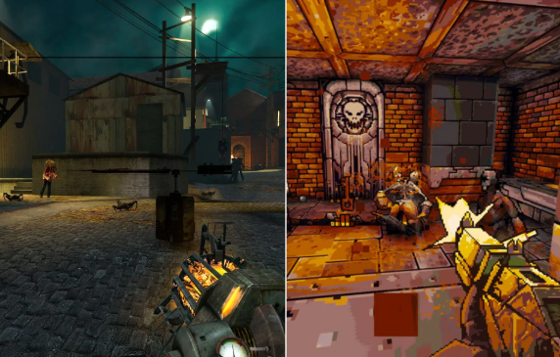
—Someone Famous
Bidhi Paudel – Subsystem 4
Weapon and Powerups
Design and implement weapon mechanics, powerups, and their interactions with the player and enemies.
Weapon Creation
Types of weapons
Implement core attributes
Projectile System
Accuracy and Interaction
Collision Detection
Weapon Integration & Powerup
DataStore
Weapon Performance
Combat Mechanics & Player Interaction
Animation
Switch Controls
“This is a quote, words full of wisdom that someone important said and can make the reader get inspired.”
Priority: 1
Complexity: 7/10

Slide 25
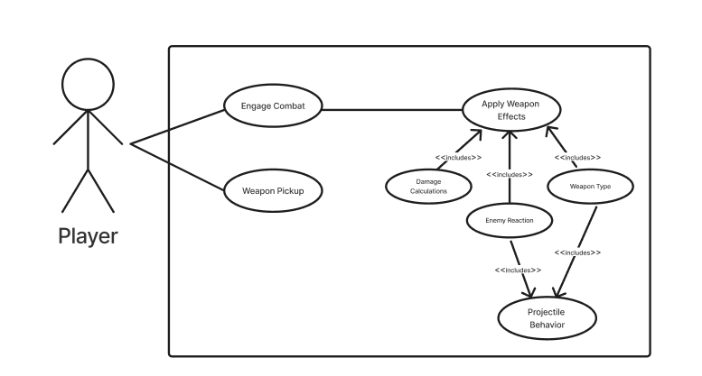
Bidhi: Use Case Diagram

Slide 26
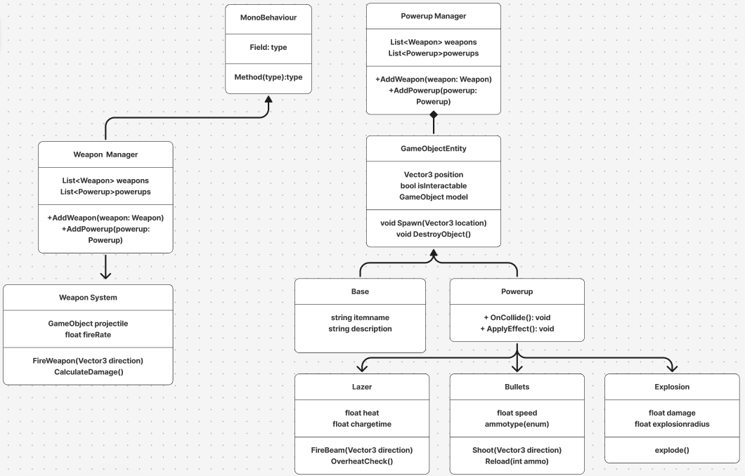
Bidhi:
Class Diagram

Slide 27
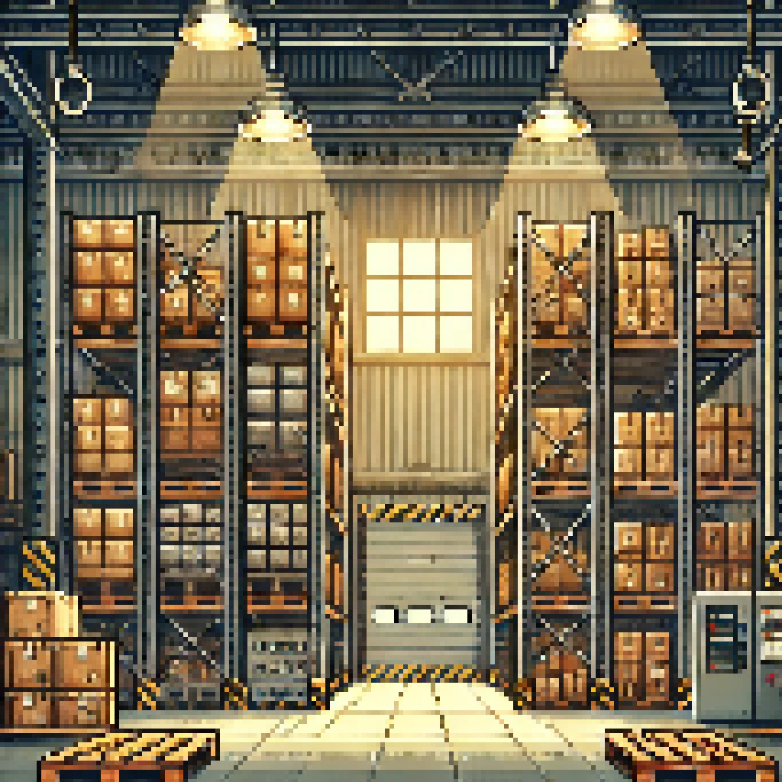
Nihat Kayra Polat –Subsystem 5 Level Designer
Traditional handcrafted/fixed levels
Tiles for fixed environment
Platforms for dynamic environment
Interactable environmental elements
Keypad
Traps
Triggered by getting in contact
Buttons, levers
Toggle to open/close,
activate/deactivate
Priority: 1
Complexity: 8/10

Slide 28
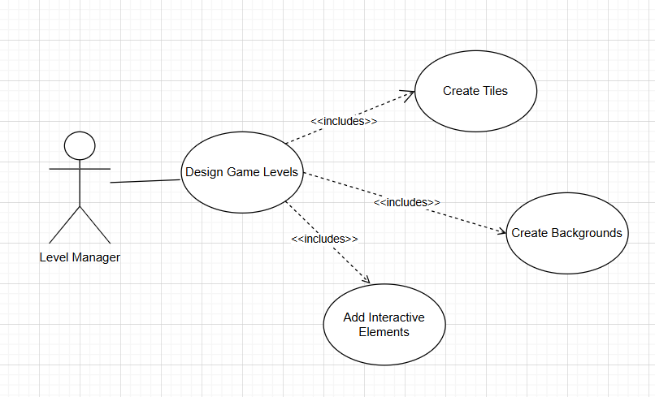
Nihat – Use Case Diagram

Slide 29
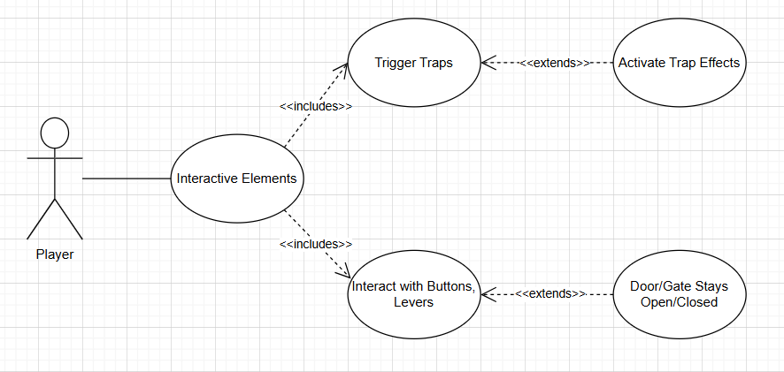
Nihat – Use Case Diagram

Slide 30
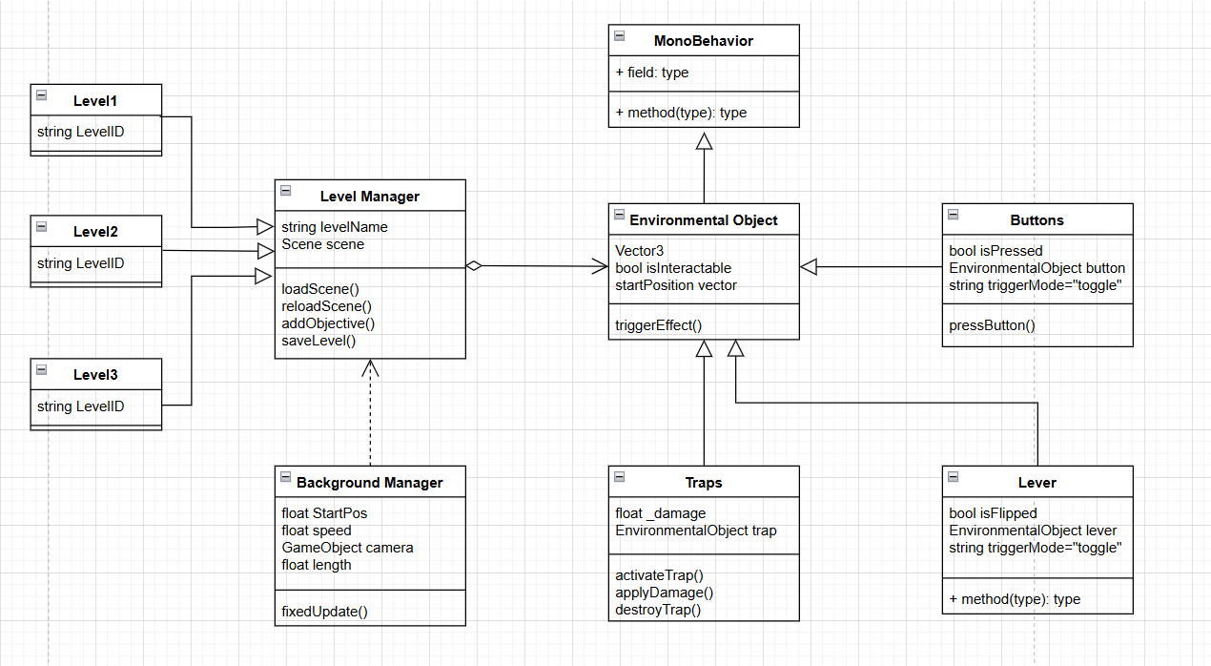
Nihat – Class Diagram

Slide 31
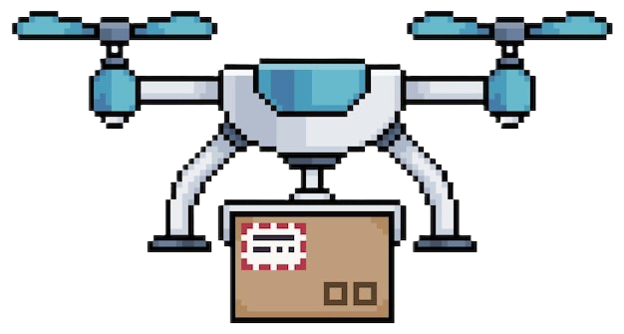
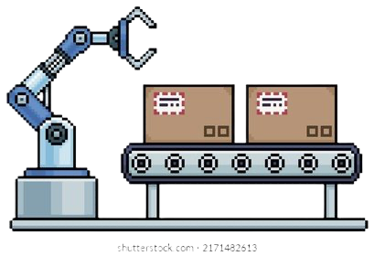
Aneesha Shrestha – Subsystem 6
Enemies!
Goal is to create 9 different kinds of enemies, 3 for each level
Each must deal and take damage to & from player
Track MC/player
Priority: 1
Complexity: 9/10

Slide 32
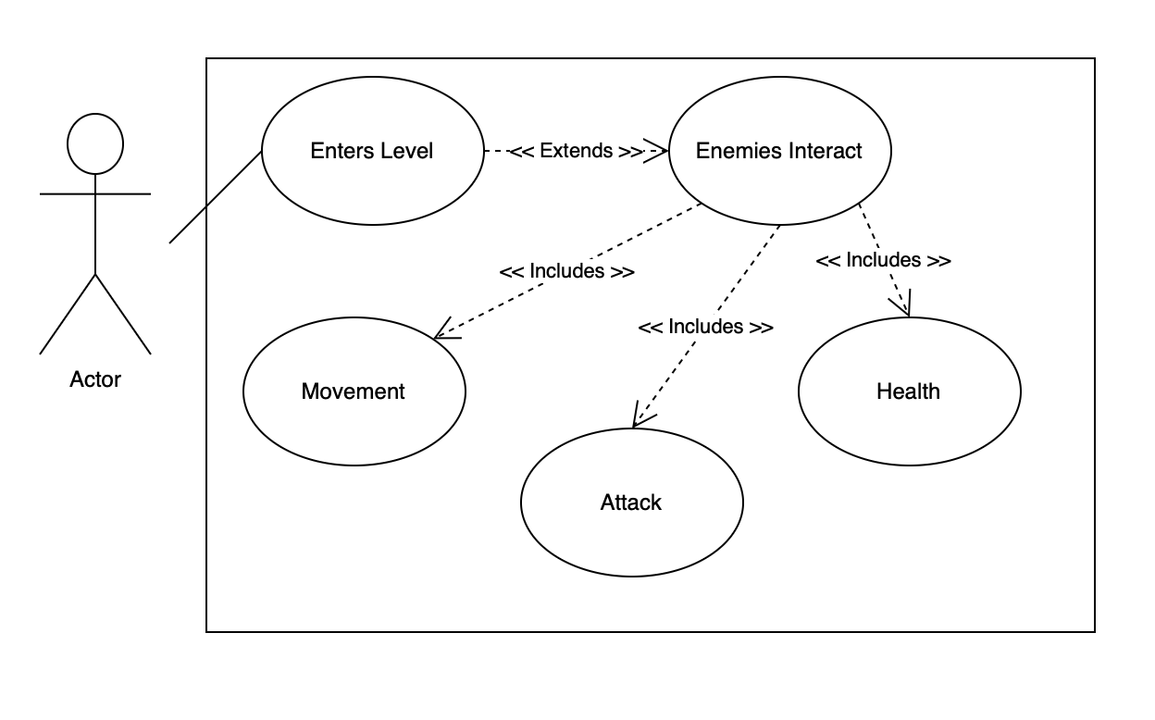
Aneesha – Use Case

Slide 33
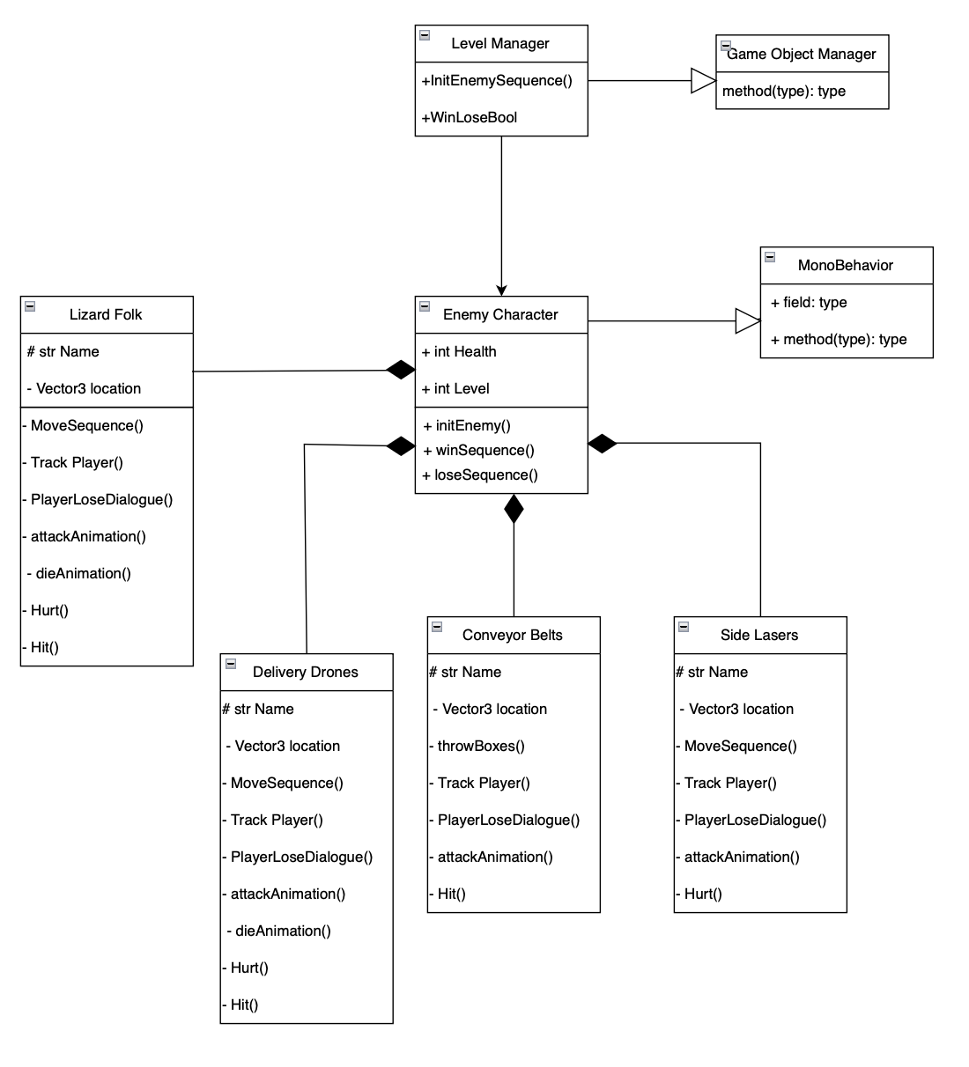
Aneesha – Class Diagram

Slide 34
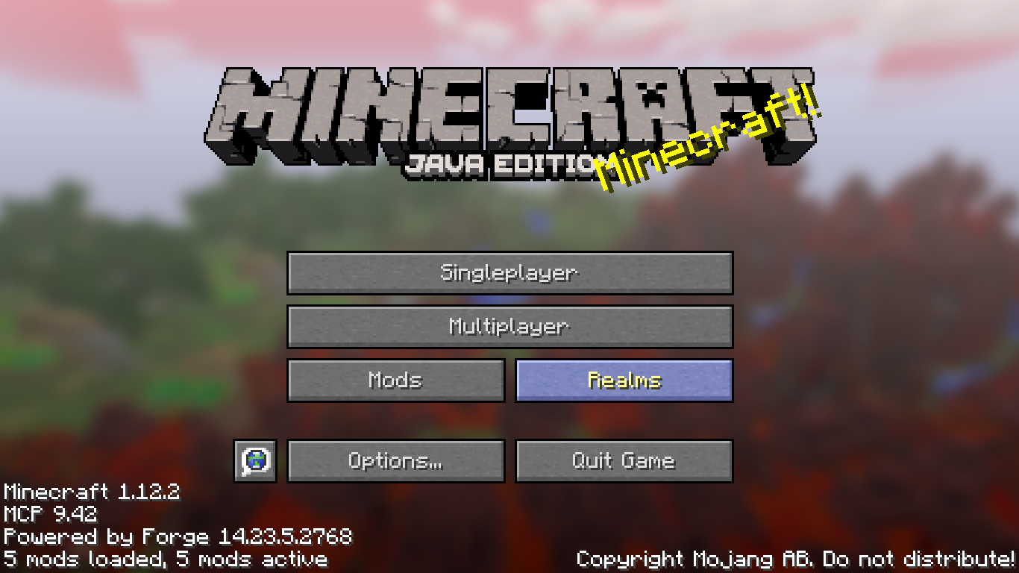
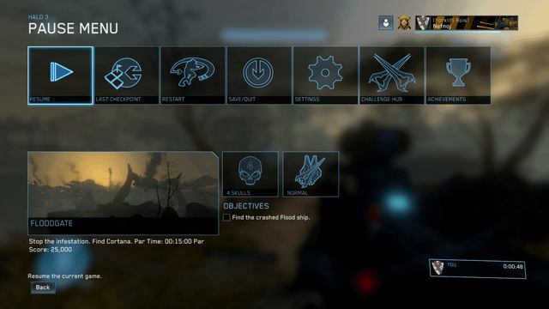
Chenny Amadike – Subsystem 7
UI and HUD
​
Menus (Pause/Game-over/Settings)​
HUD (health/ number of eliminations )​
Load buttons (Play button/Quit button)
Inventory
Complexity: 6/10
Priority: 2

Slide 35
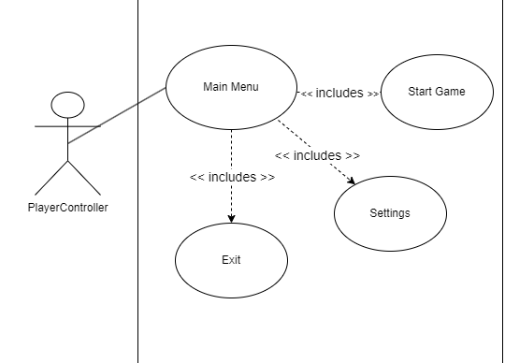
Use Case Diagram –
Chenny

Slide 36
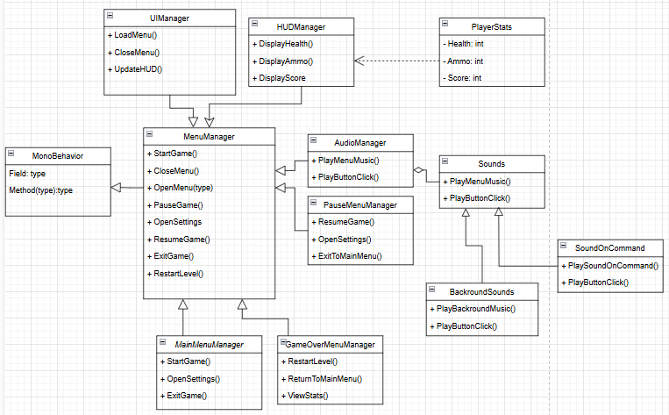
Class Diagram –
Chenny

Slide 37
Thanks for Tuning In ☺ Questions?

